Slide 1
Final Project Data Mining
By: Mitchell Hogan

Slide 2
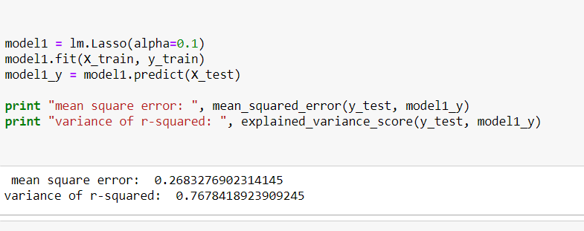

Regression
Random Forest Regression
Lasso Regression

Slide 3

Regression-Linear

Slide 4
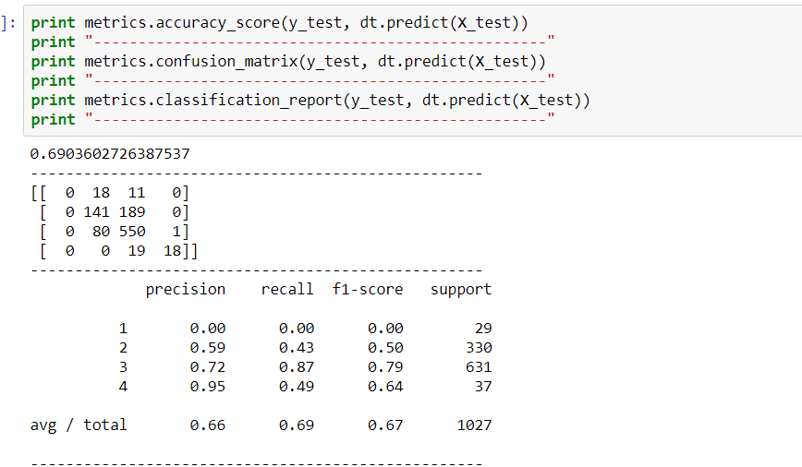
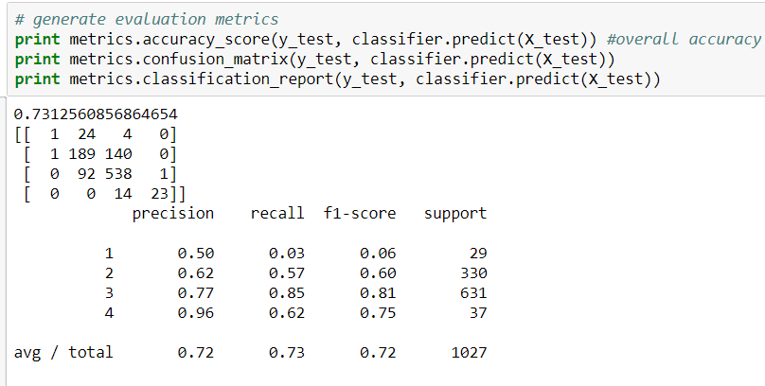
Classification
Random Forest Classification
Decision Tree

Slide 5
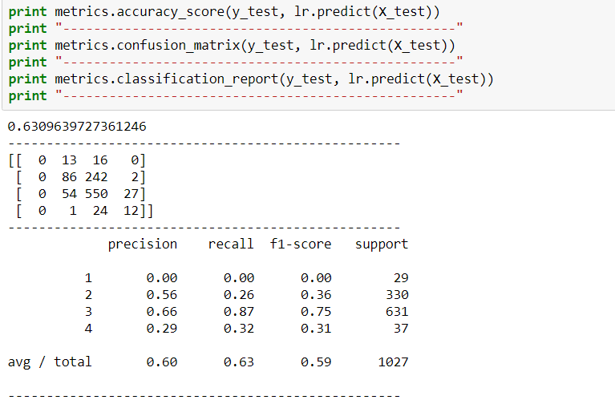
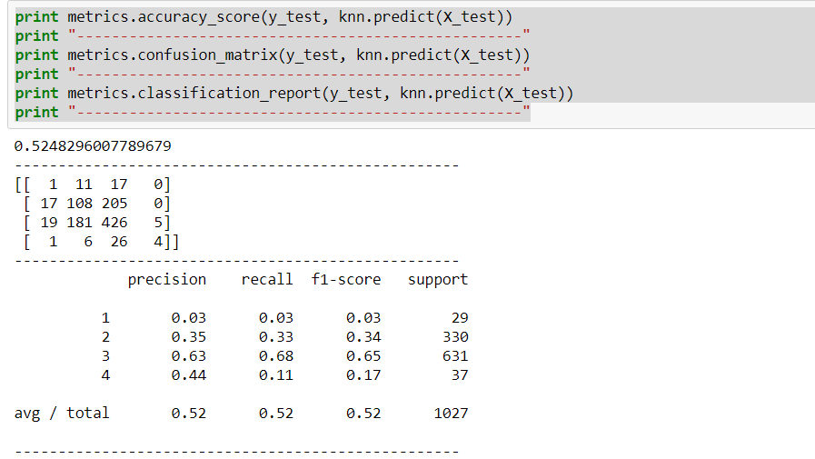
Classification
KNN
Logistic

Slide 6
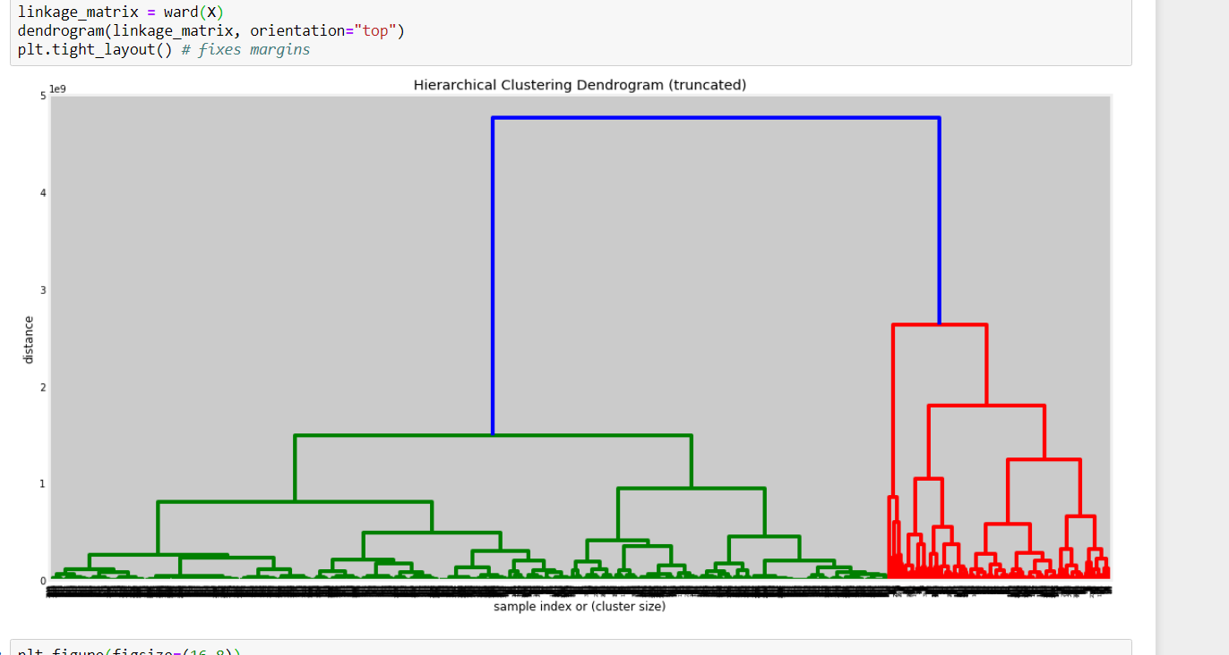
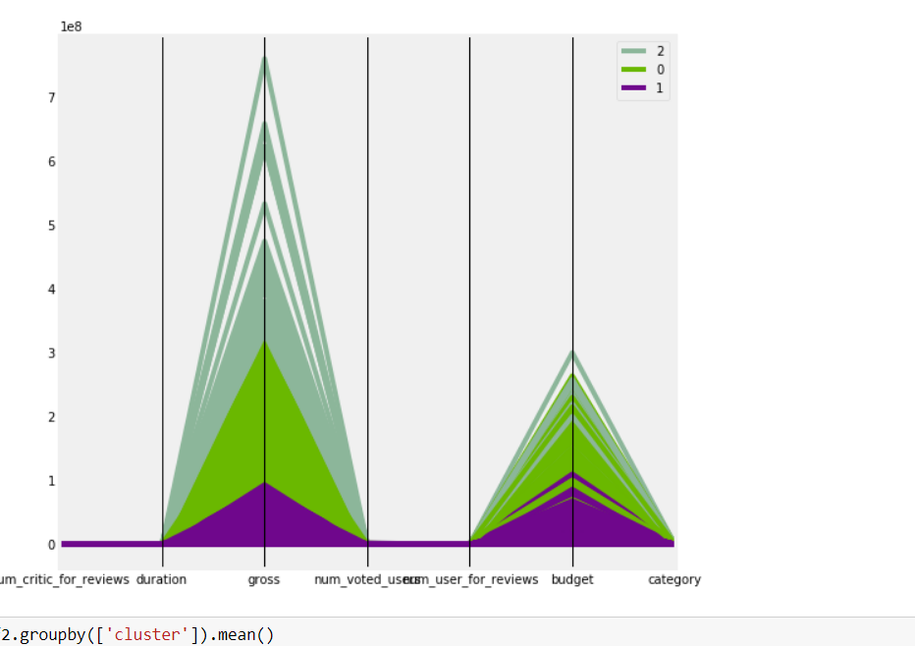
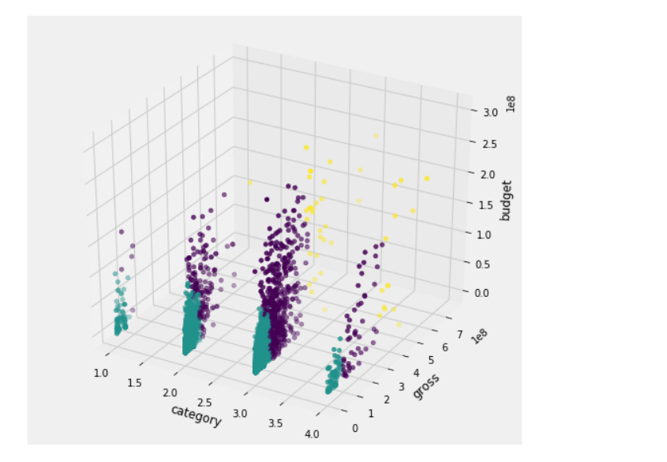
Clustering
Hierarchical clustering algorithm

Slide 7
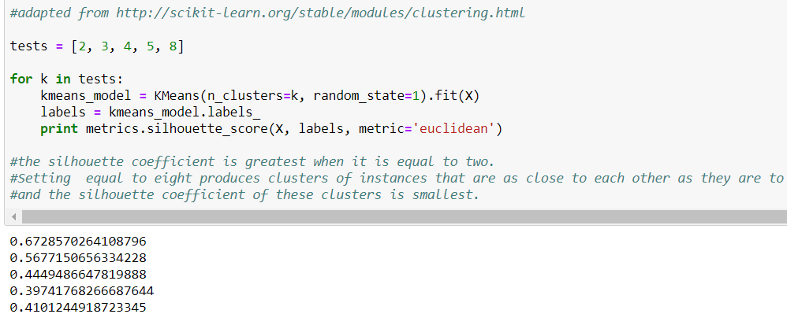
K-means

